Slide 1



Medical Inventory Optimization

Slide 2

Contents
Business Objective
Business Constraints
Project Architecture - Data Flow Diagram
Data Collection
Exploratory Data Analysis
Data Visualization
Notes:
Change

Slide 3

Business Problem
The current medical inventory system experiences drug shortages, leading to patient dissatisfaction and potential health risks.
The bounce rate (i.e., the rate at which patients leave without receiving their required medication) has increased due to insufficient stock levels.
The objective is to minimize drug shortages, maximize availability of drugs, improve customer satisfaction, and enhance profits
The bounce rate refers to the frequency of stockouts or instances where medical items are not available when needed.
Stockouts can lead to delays in patient treatment, compromise patient safety, and result in revenue loss for the healthcare facility.
Managing medical inventory effectively requires balancing the need to maintain adequate stock levels to minimize excess inventory and associated costs

Slide 4
Project Overview and Scope
OBJECTIVES
Project overview
The healthcare facility is experiencing a rising bounce rate in medical inventory, leading to frequent stockouts of essential supplies and drugs.
This issue is adversely affecting patient care delivery and operational efficiency.
The objective of this project is to address the increasing bounce rate in medical inventory and optimize inventory management processes to ensure the availability of essential supplies when needed.
Scope
The project will focus on analyzing historical inventory data, identifying patterns and trends, and developing actionable insights to optimize inventory management.
Solutions may include process improvements, technology enhancements, and supplier relationship management strategies.
Identify the root causes of stockouts and inventory inefficiencies.
Develop strategies to minimize bounce rate while optimizing inventory levels and costs.
Implement data-driven inventory management solutions and best practices to improve operational efficiency and patient care outcomes

Slide 5
Data Dictionary
VARIABLE NAME | VARIABLE DESCRIPTION
Typeofsales | Type of sale of the drug. Either the drug is sold or returned.
Patient_ID | ID of a patient
Specialisation | Name of Specialisation (eg. Cardiology)
Dept | Pharmacy, the formulation is related with.
Dateofbill | Date of purchase of medicine
Quantity | Quantity of the drug
ReturnQuantity | Quantity of drug returned by patient to the pharmacy
Final_Cost | Final Cost of the drug (Quantity included)
Final_Sales | Final sales of drug
RtnMRP | MRP of returned drug (Quantity included)
Formulation | Type of formulation
DrugName | Generic name of the drug
SubCat | Subcategory (Type) to the category of drugs.
SubCat1 | Subcategory (condition) to the category of drugs

Slide 6
Exploratory Data Analysis [EDA]
Statistical Insights
Business Insights
The Sales transaction constitutes the majority of the dataset accounting to 88.18% of total transactions.
Department1 contributes 15.61% to the overall sales volume and exhibits higher sales of return in terms of Final_Sales.
The patent category is identified as the highest-selling Formulation in terms of Final_Sales.
May, June and August are highlighted as months with higher sales of return compared to other months in year 2022.
The majority of quantities sold fall within the range 0-20 items, indicating most transactions involve relatively small quantities of items.
Specialisation54 has higher return rate of 42.86%.
The proportion of returns makes up to 11.82% of total transactions.
The products falling under the category of Specialisation54 have a relatively higher likelihood of being return compared to other Specialisations.
The products associated with Department1 experience a higher rate of returns compared to other department.
There are noticeable seasonal variations in returns with higher return rates observed during May, July and August.
Businesses may need to investigate the reason behind these seasonal fluctuations to implement targeted strategies for reducing returns during peak return season.
Notes:
EDA is used for seeing what the data can tell us before the modeling task.
Change

Slide 7
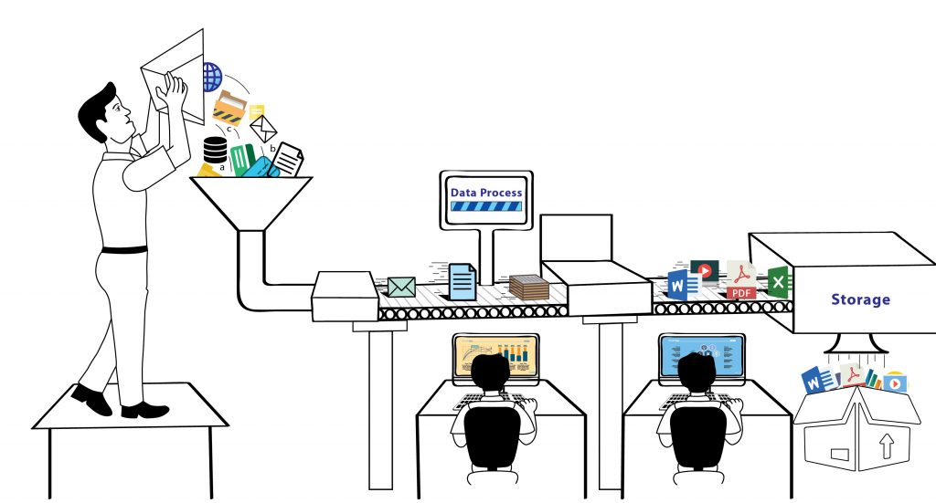


Data Preprocessing
Cleaning and preprocessing are essential stages in the data pipeline, laying the foundation for meaningful insights and decision-making.
We use the isnull() function to identify null values.
It's crucial to check for missing values in our dataset.
Any missing values found are replaced with 'Unknown' to maintain data integrity
The 'Dateofbill' column is initially in text format.
We convert it into datetime format for easier manipulation and analysis.
This ensures consistency and accuracy in date-related operations.
Notes:
Keep observations

Slide 8
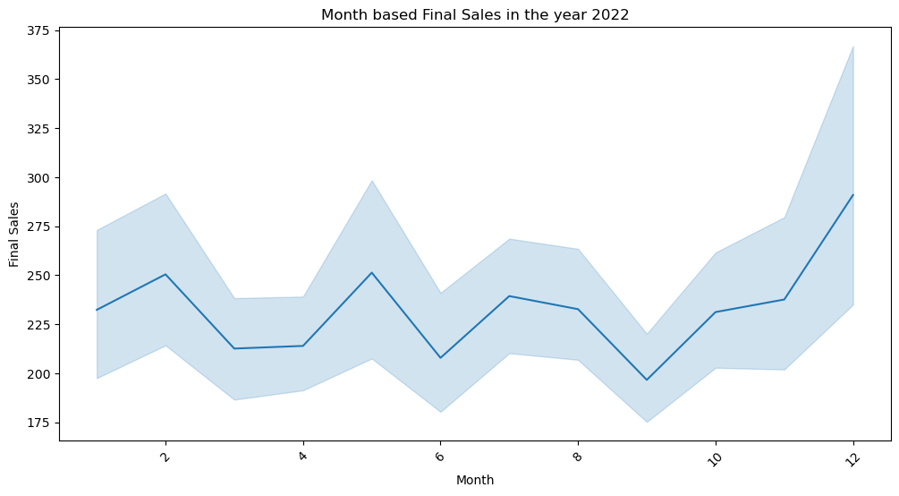
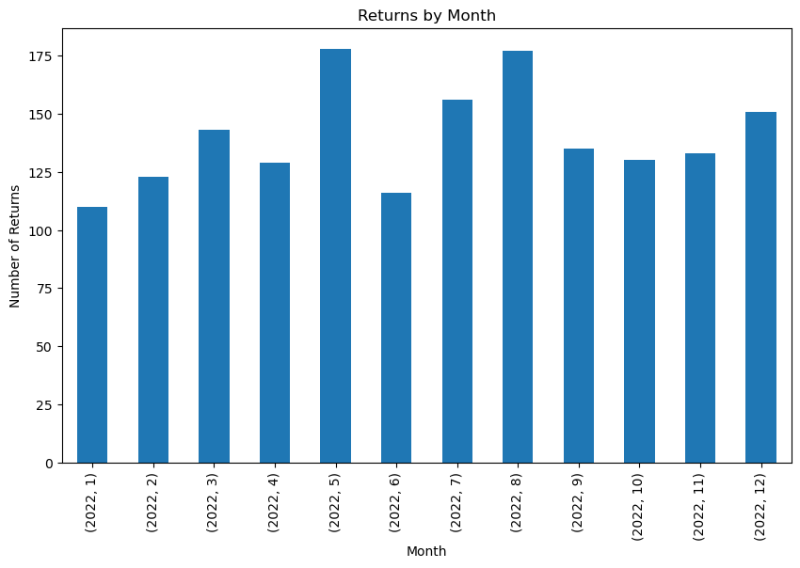
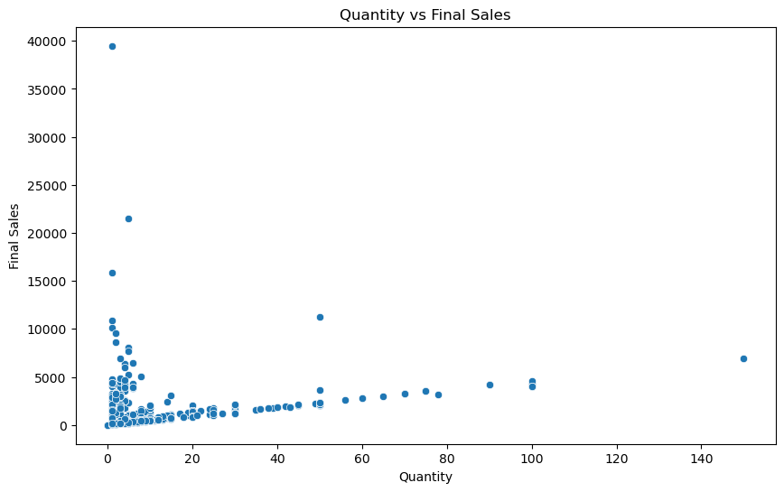
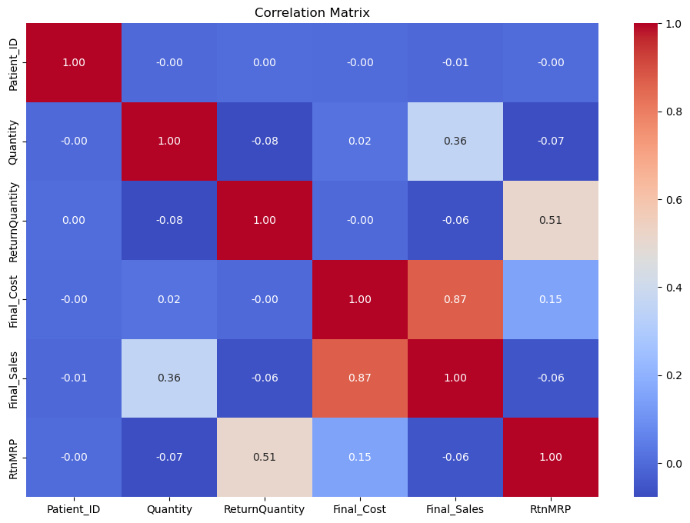
Data Visualization
Notes:
Add graphical

Slide 9


